Slide 1
Delivery On-time and Demand Forecast Insights

Slide 2
Table of Contents
01 Knowledge and actionable insights
04 SLA & Processing Center Count impact on delivery
02 Delivery on-time challenges
05 Item volume at acceptance offices
03 Transportation impact on delays
06 Seasonality impact

Slide 3
Knowledge and Actionable Insights

Slide 4
Delivery On-time Data Analysis Findings Is Divided Into Knowledge And Actionable Insight Output
Knowledge
Actionable Insights
Transportation
End-to-end transit time have the most significant impact on delivery delays
Transit time impact items with SLA of 2 days significantly
Pick up interval contributes massively to transit time delay for ecommerce items
Pick up interval should be more efficient as it contributes significantly to transit time impact on ecommerce delivery delays
Transit time for items with SLA of 2 days should be given high priority in order to reduce delays
SLA
SLA of 2 and 4 days impacts delivery delays
Out of region delivery for SLA 2 & 4 days affects delivery negatively
Same region delivery is mostly on-time across all SLA types
SLA of 2 days should be reviewed as it’s associated with delays
Distribution office acceptance category should be made more efficient as the probability of delays for items with SLA of 2 days is associated with “distribution offices”
Processing Center
Processing center count contributes to delays, delivered at main city
Probability of delays is high for main city delivery items
Increase in processing center counts for an items is associated with delivery delays
Accurate sorting of items mapped to the right processing center at the acceptance office
Processing center count for main city items should be maximum of two (2)
Delivery/Acceptance City Category
Delivery and Acceptance City category impacts the probability of delay for an item.
Probability of delays is higher for items sent for one main city to another main city.
SLA should be reviewed for items delivered from one main city to another main city.
Number of processing center for items sent from one main city to another main city should be maximum of one (1)
SLA for items sent from one main city to another should be minimum of two days (2)

Slide 5







Highlights Of Key Actionable Insights
Prioritization of transit items with SLA of 2 days and changing SLA “2 days” to “3 days” will decrease delivery delay by 45%
Delivery items that are “Out of region” and “Main city” SLA’s should be reviewed
Processing center counts for Main City delivery should not exceed two (2) processing centers
*** Required Actions
Main city to main city delivery should have an SLA of 2 days and a maximum processing center count of one (1)

Slide 6
Delivery On-time Challenges

Slide 7
What Are The Factors Affecting Delivery On-time Of An Item?
Transportation impacts delivery delays significantly
1
SLA
2
Processing Center Count
3
Delivery/Acceptance City Category
4

Slide 8
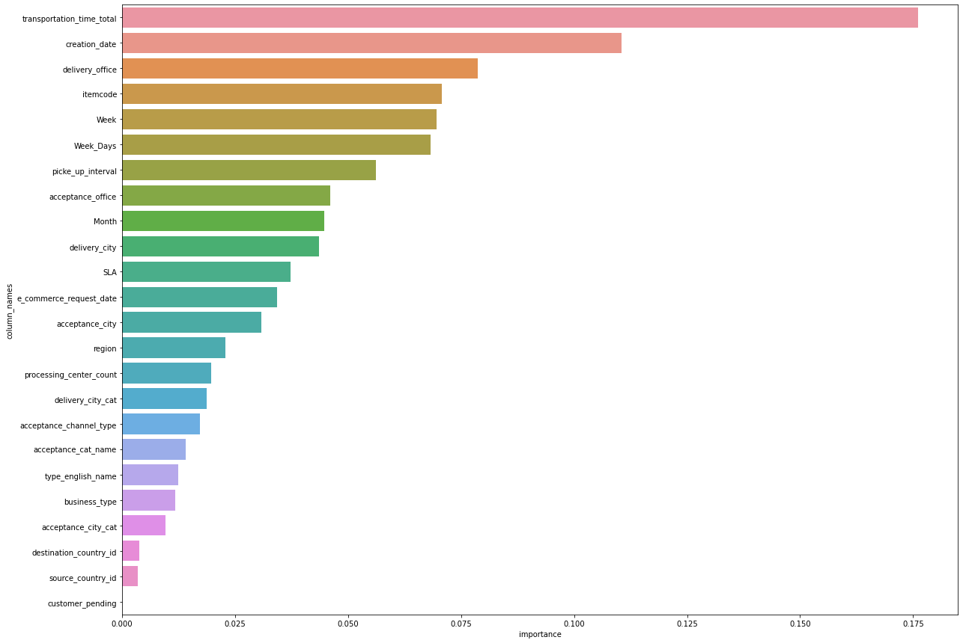
Machine learning model output highlighting factors affecting delivery delays

Slide 9
Transit time impact on delivery delay

Slide 10
Impact of transit time on delivery delays from acceptance to last mile
Transit time affect official offices acceptance categrory the most compared to other acceptance categories
Product types with high probability of delay at acceptance office:
E-commerce product have high probability of delay
International Inbound
Torod Economy
Printed Products
Pick up delay at acceptance officies constitute 37% of transit time delay
There are acceptance office/sorting centers with significant pick up delays:
Processes & quality control Riyadh - Wasel
Processes & quality control Jeddah - Wasel
Processes & quality control Dammam - Wasel
Central Post in Riyadh
Transit time impacts delivery offices significantly
The delivery office that are impacted the most by transit time:
Tabouk DCS
Almsadeh DCS
HQ Maidna DCS
Noziah DCS
Processes a& quality control Riyadh - Wasel
1
2
3
4
5
6
Transit time impact the acceptance channel for an item
Acceptance channels with high impact to transit time delays:
E-commerce Picked up by courier
POS
E-commerce drop in office
As the number of processing center increase, delay due to transit time also increases across all delivery cities and offices
Processing center count of more than 2 increase the probability of delay for an item for both Main City and Sub City
Processing center cout of 1 has significantly low probability of delay
Main city delivery category is heavily impacted by transit time delays compared to Sub city delivery category

Slide 11
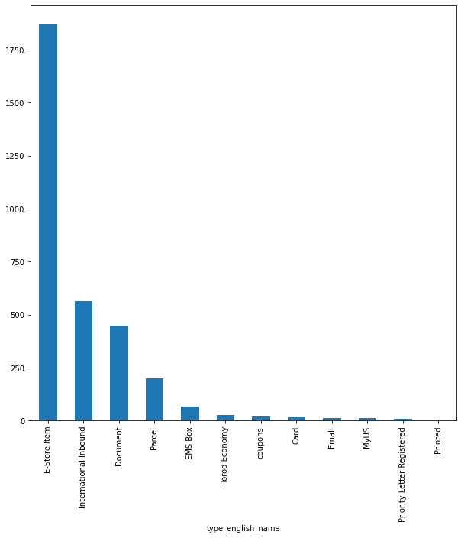
Product types affected by transit time delays
Number of delays by product types impacted by transit time
E-commerce items have the highest number of delays compared to other products
There is a 38% likelihood that an E-store item will be delayed delivery
Out of a 100 E-store items 38 will most likely be delivered late
Printed registered have almost 0% chance of delay
Out of 100 document product type 6 will mostly be delayed delivery

Slide 12
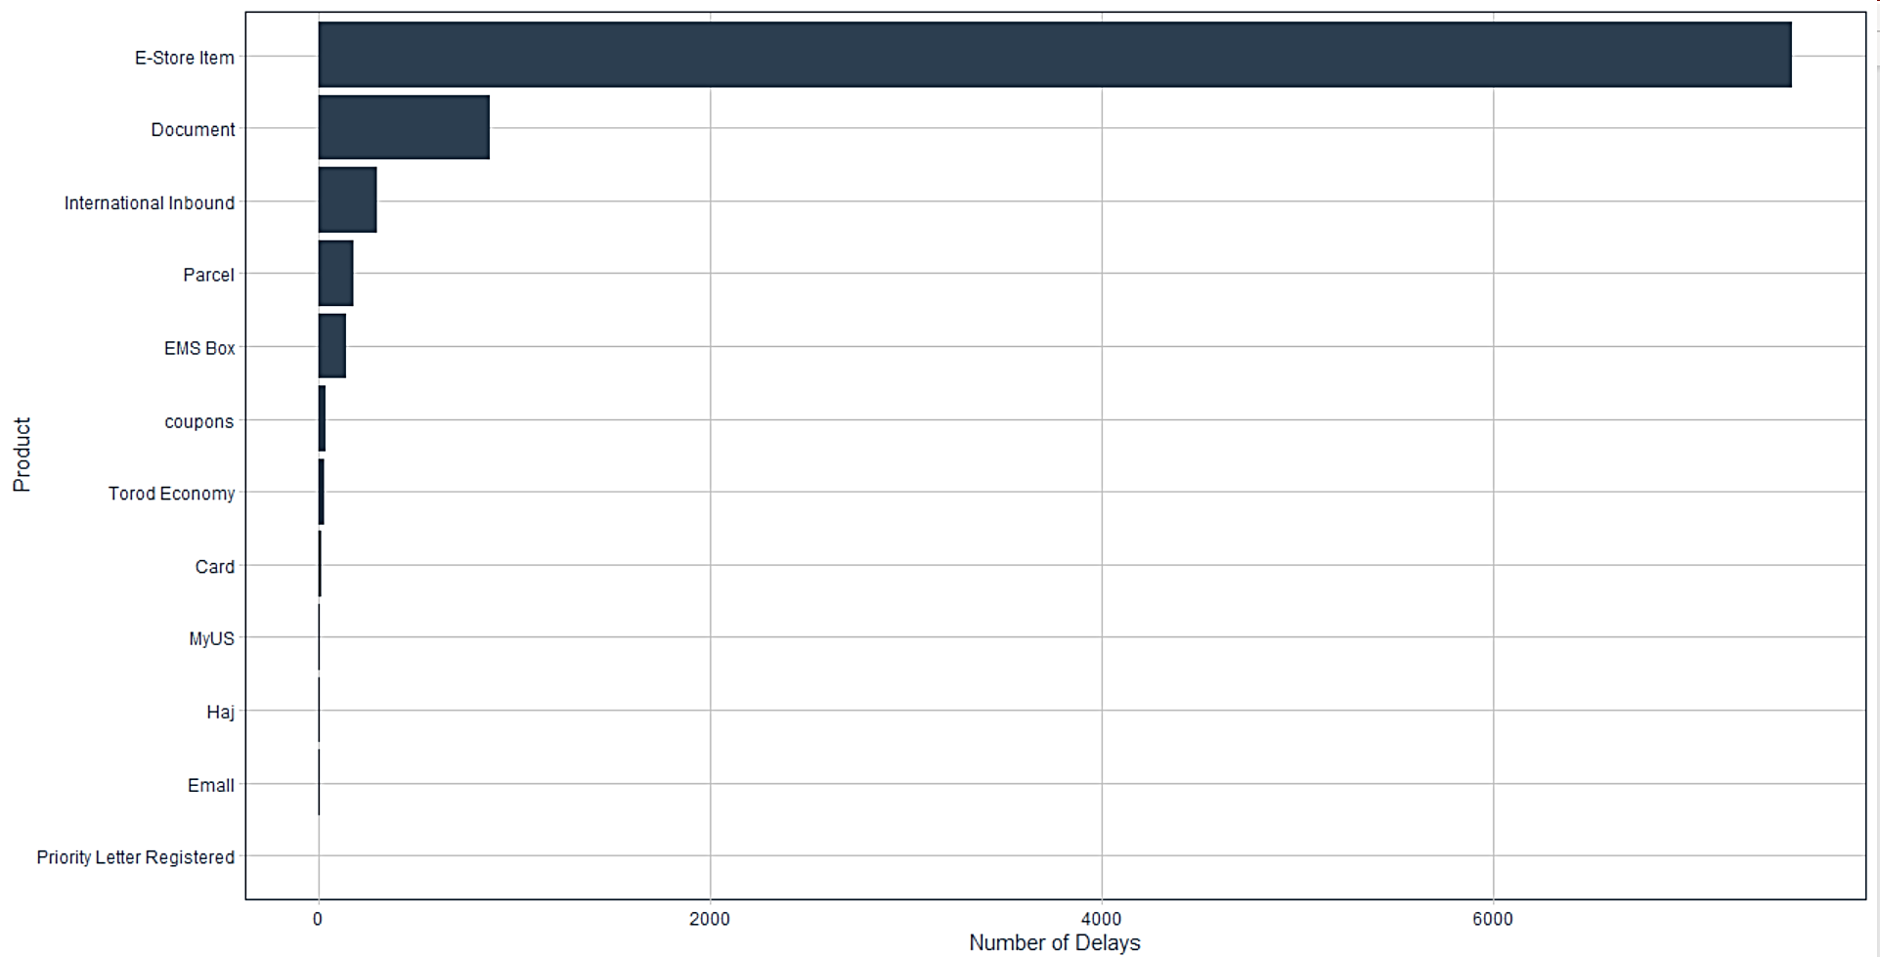
Product types affected by transit time delays
Number of delays by product types impacted by transit time
E-commerce items have the highest number of delays compared to other products
There is a 33% likelihood that an E-store item will be delayed delivery
Out of a 100 E-store items 33 will most likely be delivered late
Priority letter registered have almost 0% chance of delay
Out of 100 document product type 6 will mostly be delayed delivery

Slide 13
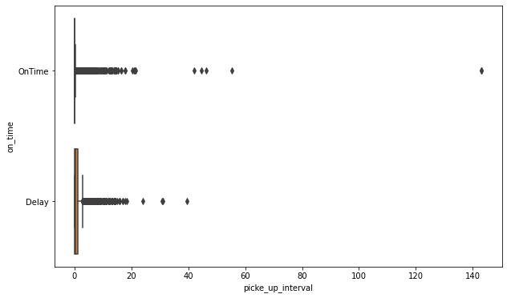
Pick up delay at acceptance office is a mojor contribution to delivery delay for ecommerce items
Impact of pick up at acceptance office on delivery status
As pick up interval or duration increases, the probability of delay also increases

Slide 14
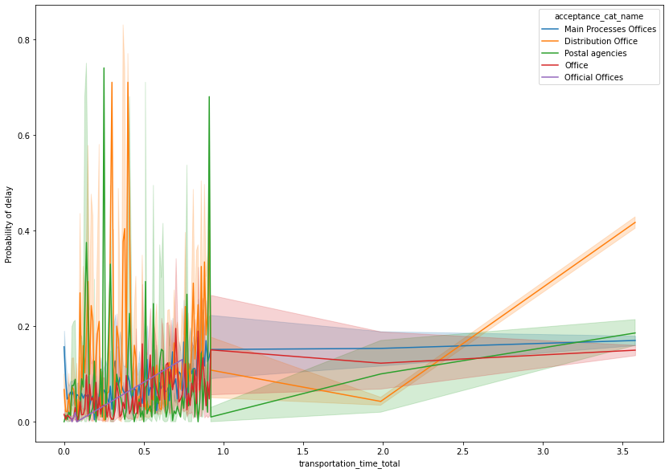
Impact of transit time on acceptance category delay
Official offices have the highest probability of delay compared to other acceptance category
Transit time (days)

Slide 15
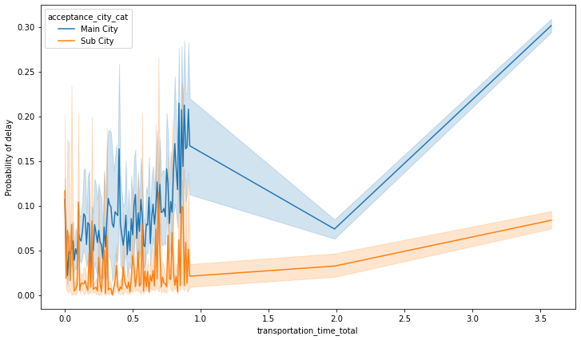
The impact of trasportation on delivery city category delay
Transportation impact main city delivery significantly

Slide 16
SLA Impact on delivery delay

Slide 17
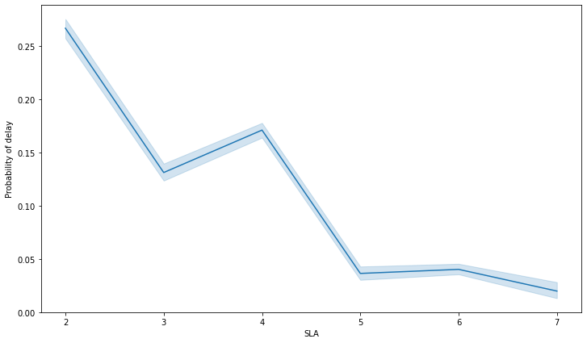
There is a 27% probability for an item with SLA of 2 days to be delivered late
SLA of 2 days have the highest probability of delay
Chart Summary
SLA of 5,6 & 7 have the lowest probability of delay
Changing SLA of 2 days to 3 days will decrease the probability of delay of an item by 27%
SLA of 7 days shows the lowest possible probability of delay for an item

Slide 18
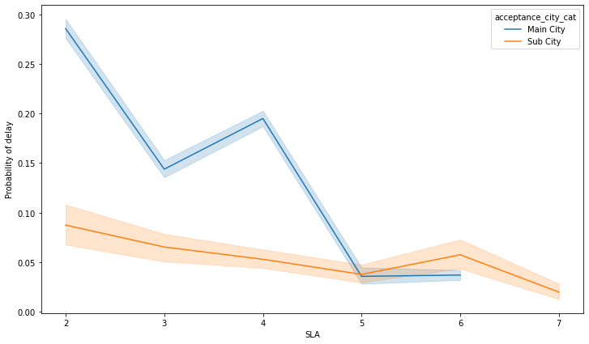
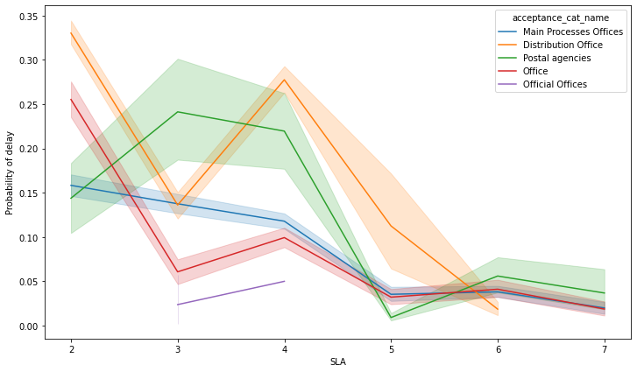
Sub City delivery category and distribution office acceptance category
Probability of delay is high for Main City category compared to Sub City
There is a 34% probability of delay for an item from the Distribution Office with an SLA of 2 days.
There is a 28% probability of delay for an item that will be delivered to a main city compared to 9% to a sub city for SLA of 2 days.
There is a sharp drop in probability of delays for both Main City and Sub City for an SLA of 3 days
There is an increase in probability of delay for both Main City and Sub City for an SLA of 6 days
There’s a decrease in probability of delay for items delivered to Sub City with an SLA of 7 days
Official office acceptance category have low probability of delay compared to other acceptance category.
SLA of 5 ,6 & 7 days have low probability of delay across all acceptance category offices.
There is a significant increase in the probability of delay for official offices, Distribution office and Office acceptance categories with respect to SLA of 4 days
The probability of delay is really significant for distribution office acceptance category.

Slide 19
Processing center count on impact on delivery delay

Slide 20







Delivery delay relationship with processing center
Main city delivery is significantly impacted by an increase in the number of processing center for an item.
International inbound items is heavily impacted by an increase in processing center count compared to other product types
Processing center
count
Parcel business item is significantly impact by processing center count compared to other business types like EMS, Official mail and Register
Office and postal agency acceptance category is impacted negatively by an increase in processing center count
As processing center count increases, coupons product type delay also increase

Slide 21
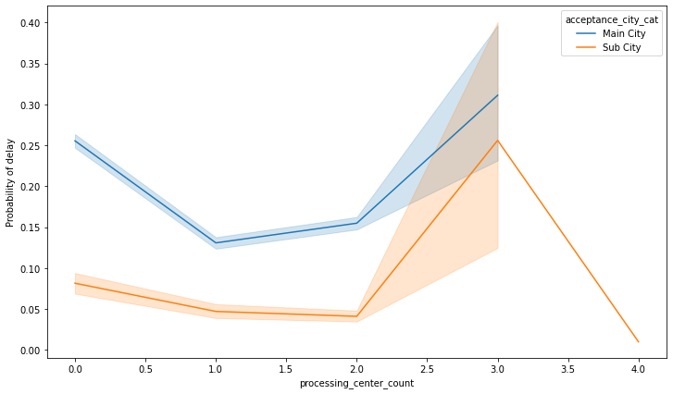
Processing center count impact on delivery city categORy
The probability of delay for Main City and Sub City delivery increases as the number of processing center increases for an item. The probability of delay spikes to 30% and 25% for Main City and Sub City respectively for acceptance city with a 3 processing centers.
It’s best to have one or two at most processing centers in a Main City.
It is more effective to have at most two processing centers in the Sub City.

Slide 22
DELIVERY/ACCEPTANCE CITY CATEGORY AND impact on delivery delay

Slide 23
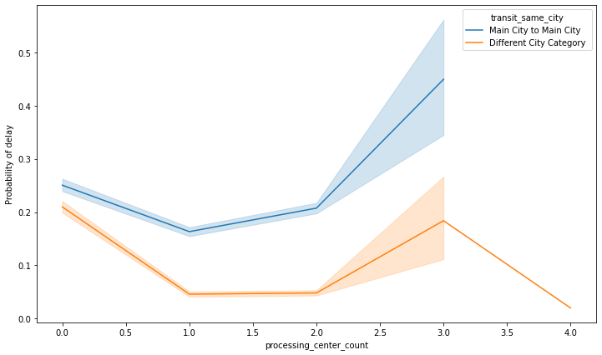
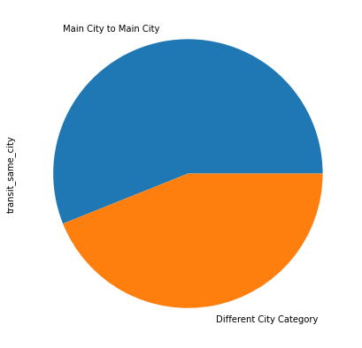
Delivery delay relationship with Acceptance/Delivery City Category
56% of the Items were delivered from one Main city to another Main city.
Best number of processing center
56%
44%
The probability that an item will be delayed is low for items delivered from a main city to Sub City or Sub City to Main City.
There’s a 45% probability of delay for an item sent from a Main City to a Sub City of FOUR processing centers.

Slide 24
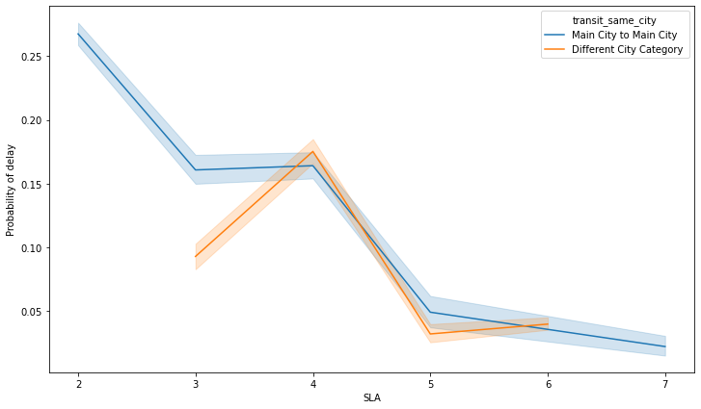
There is a 28% probability for an item SENT FROM A MAIN CITY TO ANOTHER MAIN CITY with AN SLA of 2 days to be delivered late
SLA of 2 days have the highest contribution to the probability of delay
Chart Summary
SLA of 5,6 & 7 have the lowest probability of delay
There’s 18% probability that an item with an SLA of 4 days will be delayed when sent from cities in different categories.

Slide 25
The End

